Slide 1
The Calling of Levi – Mark 2:13-17
Then Jesus went again to walk alongside the lake. Again a crowd came to him, and he taught them. Strolling along, he saw Levi, son of Alphaeus, at his work collecting taxes. Jesus said, “Come along with me.” He came. Later Jesus and his disciples were at home having supper with a collection of disreputable guests. Unlikely as it seems, more than a few of them had become followers. The religion scholars and Pharisees saw him keeping this kind of company and lit into his disciples: “What kind of example is this, acting cozy with the riffraff?” Jesus, overhearing, shot back, “Who needs a doctor: the healthy or the sick? I’m here inviting the sin-sick, not the spiritually-fit.” (Msg)
@REVxMLJ

Slide 2
What Sort of Company
do YOU Keep?
@REVxMLJ

Slide 3
The Calling of Levi – Mark 2:13-17
Levi & Co
Pharisees
Jesus
Riff Raff
Religious
Redeemer
Riff Raff Encounter God
Religious
Counter -Act God
Redeemer Is God
@REVxMLJ

Slide 4
What Sort of Company do YOU Keep?
Who are more lost?
The so-called Riff-Raff
or the Religious?
@REVxMLJ

Slide 5
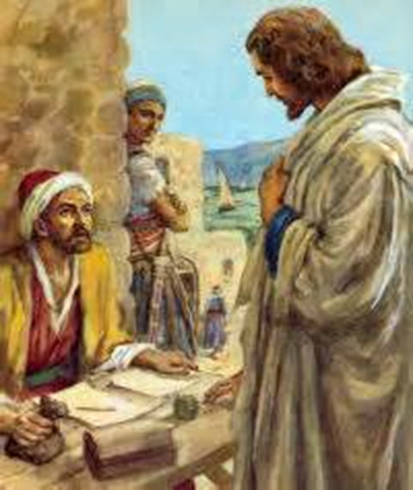
Representing the Riff-Raff
Levi – The Tax Collector
@REVxMLJ

Slide 6
Representing the Religious -
The Pharisees
@REVxMLJ

Slide 7
Representing Redemption – Jesus
@REVxMLJ

Slide 8
The Cross in the middle of Bedlam
@REVxMLJ

Slide 9
The Good News of Jesus comes right to YOU
@REVxMLJ

